Slide 1
Chapter 1
Integers
Part 3: Subtracting Integers

Slide 2
Objective
Apply rules for subtracting integers.

Slide 3
Subtracting Integers
The easiest way to subtract integers is to change the problem to an addition problem and follow the rules you already know. Use the following rules for subtracting integers:
Change the subtraction sign to addition.
Change the sign of the second number to the opposite sign.

Slide 4
Subtract: -6 – (-2)=
Change the subtraction sign to addition and -2 to 2.
-6 – (-2) = -6 + 2 = (-4)

Slide 5
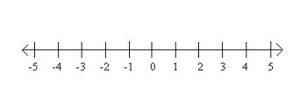
Subtract: 5 – 6=
Change the subtraction sign to addition and 6 to -6.
5-6 = 5 + (-6)= (-1)

Slide 6
Solve the problems below using your number line.
6 - (-7)
(-3) - 8
(-2) – (-6)
8 - (-9)
(-4) - (-1)

Slide 7
Solve the addition and subtraction problems.
(-4)+ 14
(-12) + (-2)
2 - (-5)
(-4) – 11
(-25) + 5
-13+ 12
62 - (-3)
(-25) + 5
-40 – (-5)
(-25) + 5

